Slide 1
COVID-19 & Real Estate
Exploring the implications of covid-19 on the real estate market and trying to predict rental/selling prices during and after the pandemic
Team members: Sindhuja Rao, Tomas Ortega

Slide 2
Agenda
Overview
Phase 1: Business Understanding
Objectives & Background Information
Literature Review
Phase 2: Data Collection & Preparation
Future work
Project Timeline
References

Slide 3
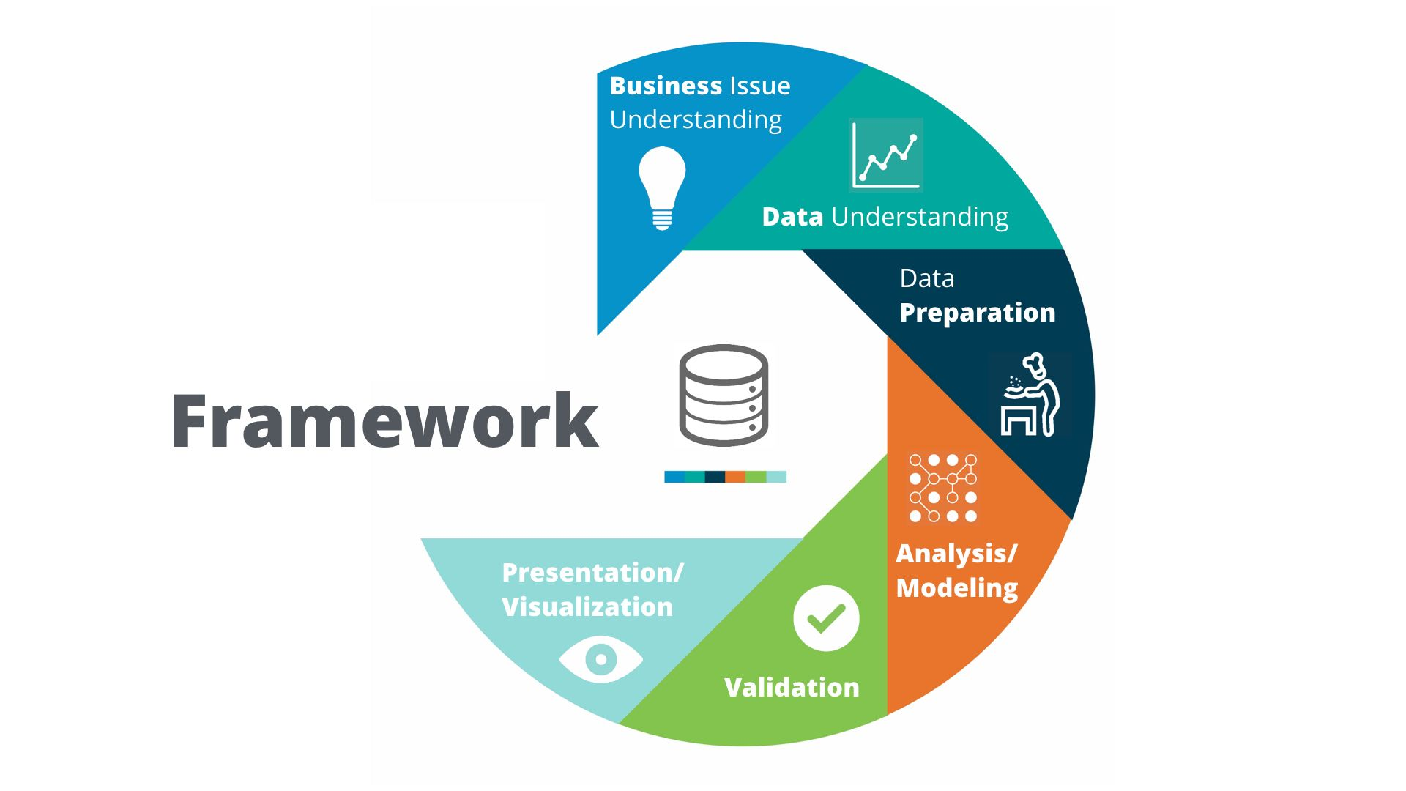
OVERVIEW : CRISP DM
Notes:
Crisp dm implementation for our project

Slide 4
Phase 1:
Business Understanding

Slide 5
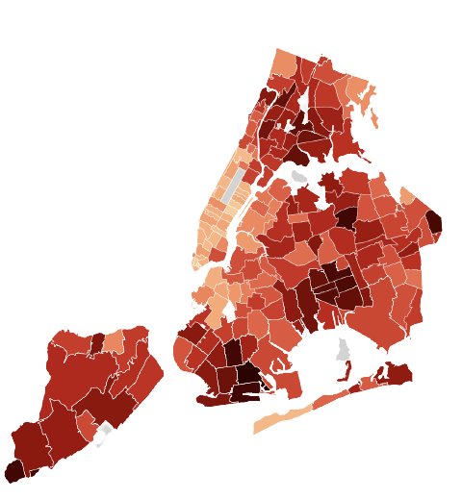

Objectives
Explore the correlation between the number of COVID-19 cases and residential/commercial Real Estate Prices in New York
Notes:
From the point of view of a Real Estate Firm, knowing what locations are least/most profitable is important because it increases the chances of avoiding risk and leads to an increase of profits. .

Slide 6
Background Information
It’s been almost a year since the official declaration of the COVID-19 pandemic. (March 11th, 2020). The implications of this global event have reached essentially every sector of the global economy, and Real Estate is no exception.
The COVID-19 pandemic is causing a dramatic reduction in consumption, with a further drop in prices and a decrease in workers’ per capita income.
The acceptance of remote work is growing rapidly and it seems that it might stay relevant for the foreseeable future.
Remote learning also has a substantial effect on the rental prices in cities where a large population are students from out of state or international students

Slide 7
More Background Information
According to “Hire a Helper” a company that helps people find local movers and moving companies, approximately 13% to 15% of people that moved at the beginning of 2020 moved because of reasons related to the pandemic. By the end of the year, this figure reached 25% of the total moving population.
They also released other surprising statistics such as:
“68% more people left New York City in 2020 than moved into it.”
“28% moved because they started working from home and no longer had to live close to work”
“31% moved to either shelter-in-place with family or to take care of family members”

Slide 8
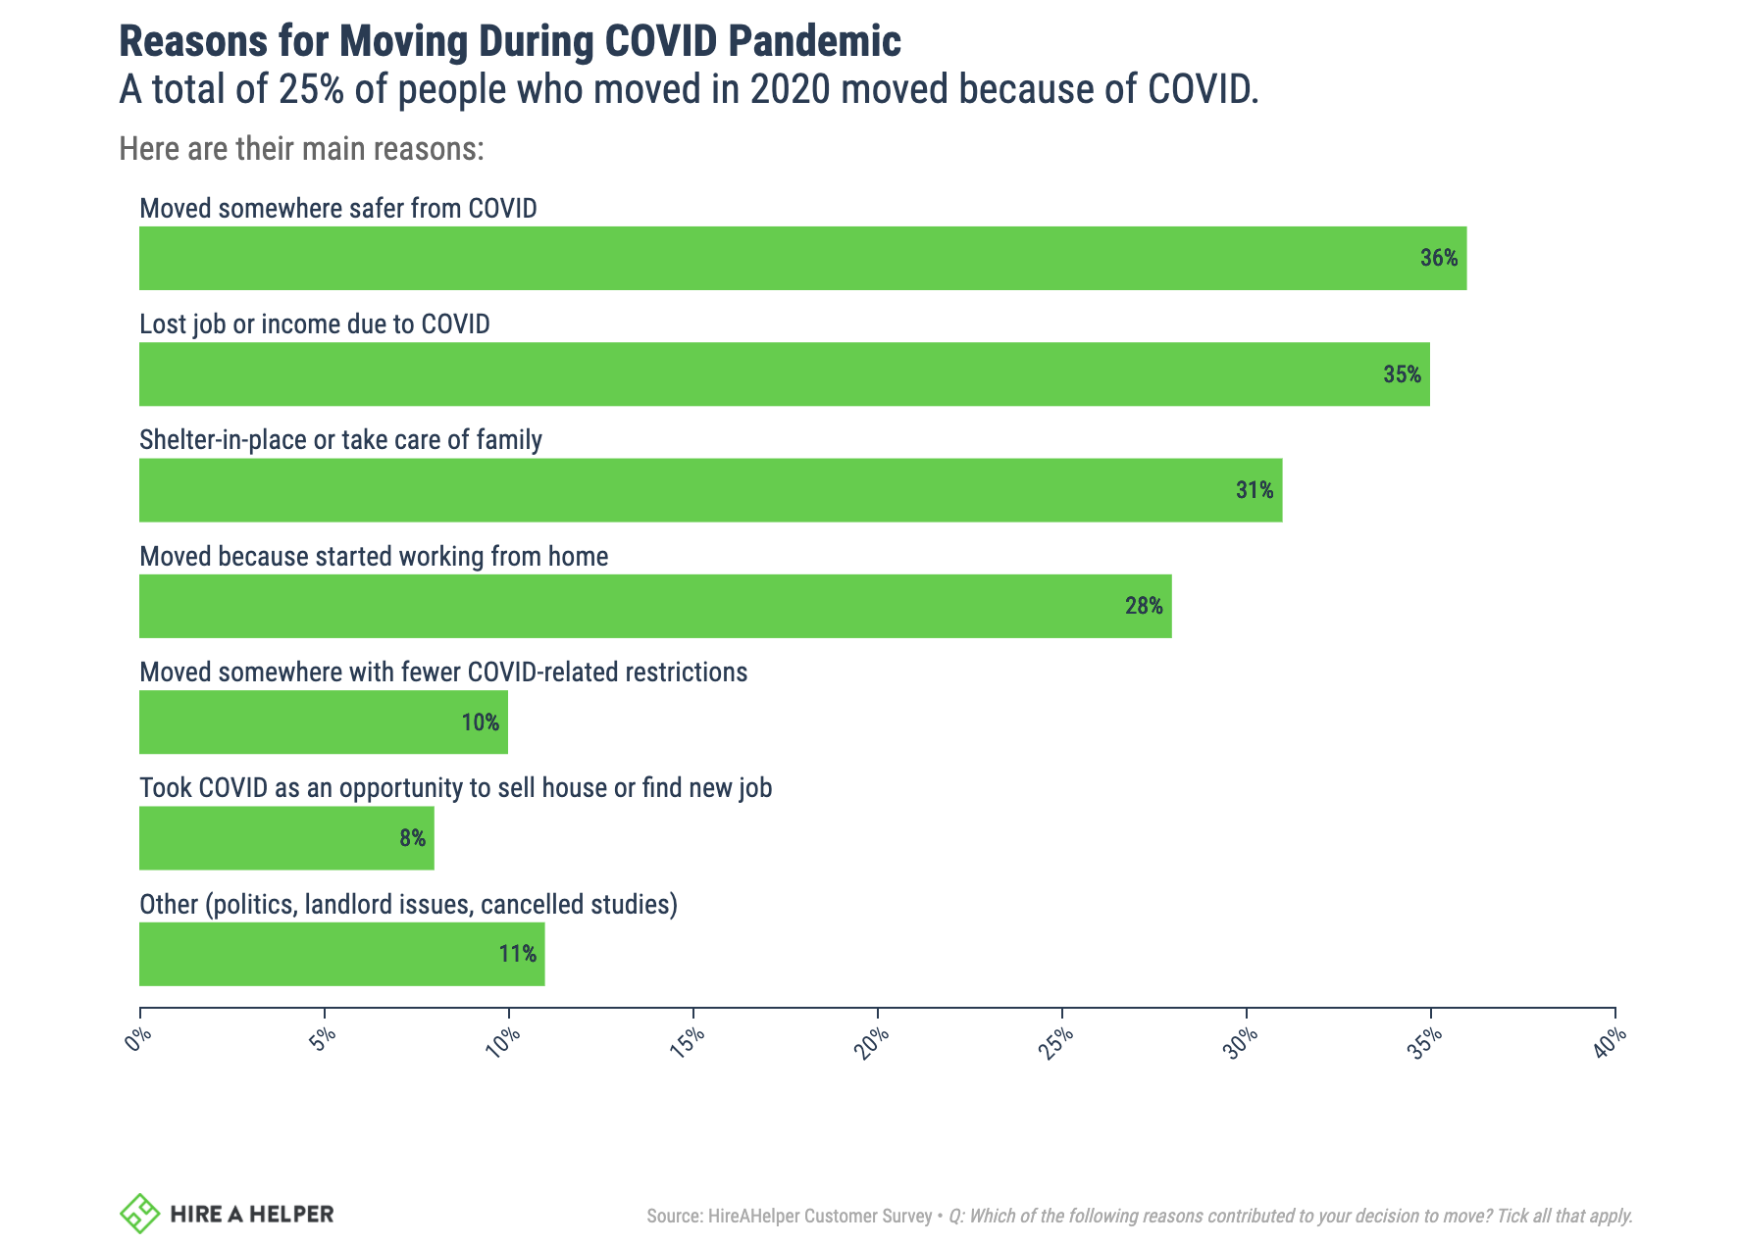

Slide 9
Literature Review 1: How Does COVID-19 Affect the Real Estate Market in Italy
In the Paper "COVID-19 Infects Real Estate Markets: Short and Mid-Run Eﬀects on Housing Prices in Campania Region", researchers were trying to estimate real estate price changes resulting from the COVID-19 pandemic.
In order to understand the impact of COVID-19, the researchers first explored more conventional models used to evaluate and predict the Average Housing Prices in a specific region.
These models used for Real Estate usually use inputs such as the GDP, the unemployment rate, residential real estate prices, and real estate transactions.
Notes:
YEAR is the year indication (the years are counted retrospectively from the present moment);
AHI is the average household income (expressed in euros); UNEMP is the number of unemployment;
PI is the per capita income (expressed in euros);
IMI is a real estate market index depending on the number of housing transactions and the number of housing stock oﬀered for sale (expressed in percentual terms);
JEX is the number of judicial foreclosures or real estate judicial execution; u z is a term related to ﬁxed but unobservables eﬀects.

Slide 10
Literature Review 1: How Does COVID-19 Affect the Real Estate Market in Italy
In the paper they determined that social and regional factors are the real estate market drivers that are most altered by the pandemic.
They used regional data as the unit of analysis because it allowed them to make community-specific and region-specific assessments of the macroeconomic drivers of real estate prices.
They found that the pandemic affected prices in several ways. Including permanent or temporary closing of neighborhoods or cities.
Using there information, they were able to find a correlation and they predicted that the average housing price will have a decrease of -4.16% in the short term and -6.49% in the mid-run (from late 2020 to early 2021)

Slide 11
Literature Review 2: Financialization, Real Estate and COVID-19 in the UK
In the UK, financialization has transformed many areas of the economy, including the housing market. The deregulation of financial markets that took place from the 1980s onwards, combined with the privatization of social housing, has transformed UK real estate from an ordinary good, insulated to some extent from consumer and financial markets, into a valuable financial asset.
The financialization of real estate has had a largely negative impact on the UK's housing market, the wider economy and individual communities; wealth inequality, financial instability, gentrification and homelessness have all increased as the role of the financial sector in UK property has increased.

Slide 12
Literature Review 2: Financialization, Real Estate and COVID-19 in the UK
The financial crisis only accelerated many of these trends as distressed real estate was bought up by investors in its wake, and as loose monetary policy pushed up house prices in the period after the crisis. The COVID-19 pandemic is only likely to exacerbate these issues; the UK is sleepwalking into a potential evictions crisis, and ongoing loose monetary policy is likely to prevent a significant and necessary correction in house prices over the long term.

Slide 13
Literature Review 3: A First Look at the Impact of Covid-19 on Commercial Real Estate Prices
The paper focuses on movement in stock prices of REITS (Real Estate Investment trusts) who own CREs (Commercial Real estate) assets.
Movements in a firm’s stock price are largely driven by the perceived current and future productivity of the firm’s underlying assets; therefore, it is important to understand how the COVID-19 shock transmits to the equity markets from a firm’s asset base.
To examine how the growth rates of COVID-19 cases affect firms differently through their asset holdings, the research involved constructing a novel firm-level measure of geographically weighted COVID-19 growth (GeoCOVID) that varies daily during sample periods.
Notes:
Reits own commercial assets CREs ->goal is to understand stock movement of reits during covid to check how covid shock got transmitted to stocks -> so built a model with target variable GeoCovid

Slide 14
Literature Review 3: A First Look at the Impact of Covid-19 on Commercial Real Estate Prices
Findings highlight the importance of the asset-level attributes of a firm’s portfolio to stock price reactions to the pandemic. Specifically, the key drivers are the property type (business) focus of the firm, the geographic allocation of assets (proxied by GeoCOVID and GeoReopen), and the interaction between these two attributes.
Their conclusion was whether the shock of COVID-19 on stock prices remains significant in the long run crucially depends on the resilience of the overall economy and, perhaps more importantly, how perceptions of risk change after the pandemic.
Notes:
Reits own commercial assets CREs ->goal is to understand stock movement of reits during covid to check how covid shock got transmitted to stocks -> so built a model with target variable GeoCovid

Slide 15
Phase 2:
Data Collection & Preparation

Slide 16
Data - Real Estate
Residential Data
Home sales data attributes: Location, neighbourhood, category, year built in, Area occupied, tax class, sale price, sale date etc.
Total number of attributes: 20
Number of records: 50000+
Renting vs Selling
Commercial Data

Slide 17
Data - COVID-19
Geographical Data on cases in New York from March 2020 until January 2021
Attributes: State, Confirmed cases, number of deaths, recovered cases, active cases, testing results and rate of testing etc.
Total number of attributes: 18
Number of records: Varied

Slide 18
Data - COVID-19
Geographical Data on vaccines in New York from January 2021 until March 2021
Attributes: County, Testing dates, New positives, Total number of tests etc.
Total number of attributes: 6
Number of records: 20000+

Slide 19
Modeling Objectives
We wish to predict the final selling price of a property based on historical data, and the number of local COVID-19 cases along with other economic indicators.
Predict the average renting price in a specific region in the short and long term.
Explore the possibility of an upward trend thanks to the vaccines and measure the impact this might have on the real estate market.
Explore if the pandemic might have any lasting effects on the state of the real estate market in New York.

Slide 20
Tools & Techniques
Python
Libraries for ML models such as:
Linear Regression,
Naive Bayes
Random Forest
If we decide to scrape data from websites like Zillow, and Realtor.com we plan to use Beautiful Soup.
We also plan to use it for data visualization purposes.
Apache Spark:
We are planning on using the spark framework to analyze the data matrix.
Tableau:
We plan on using Tableau for data visualization in this iteration of the CRISP-DM cycle.

Slide 21
Tools & Techniques
Supervised Learning:
Since our data is structured and we are dealing with labelled data (as we have the actual prices of the properties we are examining) we are planning to use supervised learning to train multiple ML models and see if we can achieve good predictive capabilities.
Granger Causality:
We plan to use granger causality to see if there is a correlation between the number and rate of increase of COVID-19 cases, and the Real Estate Market.
Since we are dealing with historical data, Granger Causality is an excellent tool to determining if COVID-19 data is actually useful for forecasting Real Estate Data.

Slide 22
Project Plan
Data Preparation Completed. Start Modeling Phase
Start the Deployment Phase. (If the Model is Approved)
Today
03.03.21
20.03.21
31.03.21
12.04.21
25.04.21
Data Assessment should be Completed. (including scrapping if necessary)
Assess the Model and Start the Model Evaluation Phase

Slide 23
References
Del Giudice, V., De Paola, P., & Del Giudice, F. P. (2020). “COVID-19 infects real Estate markets: Short And Mid-Run effects on housing prices in Campania Region (Italy)”. Social Sciences, 9(7), 114.
Ling, Wang, Zhou., (2020). “A First Look at the Impact of COVID-19 on Commercial Real Estate Prices: Asset-Level”. The Review of Asset Pricing Studies, Volume 10, Issue 4, December 2020, Pages 669–704.
Blakeley, Grace., (January 2021).Financialization, Real Estate and COVID-19 in the UK. Community Development Journal Vol. 56, Iss. 1, 79-99.
“Where are people moving to During COVID-19, in 2020 and beyond?” (n.d.). Retrieved March 03, 2021, from https://www.hireahelper.com/moving-statistics/migration-report/

